Slide 1
Microprocessor & Assembly Language

Slide 2

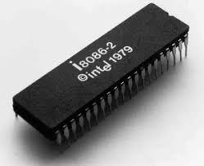
8086 Microprocessor

Slide 3
Functional blocks
Microprocessor
Computational Unit; performs arithmetic and logic operations
Various conditions of the results are stored as status bits called flags in flag register
Internal storage of data
Register array or internal memory
Data Bus
ALU
Generates the address of the instructions to be fetched from the memory and send through address bus to the memory
Flag Register
Instruction decoding unit
Timing and control unit
PC/ IP
Control Bus
Address Bus
Generates control signals for internal and external operations of the microprocessor
Decodes instructions; sends information to the timing and control unit

Slide 4
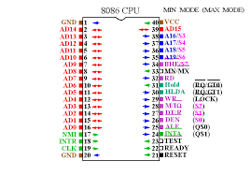
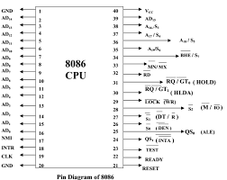
8086 Pin Diagram and signals

Slide 5
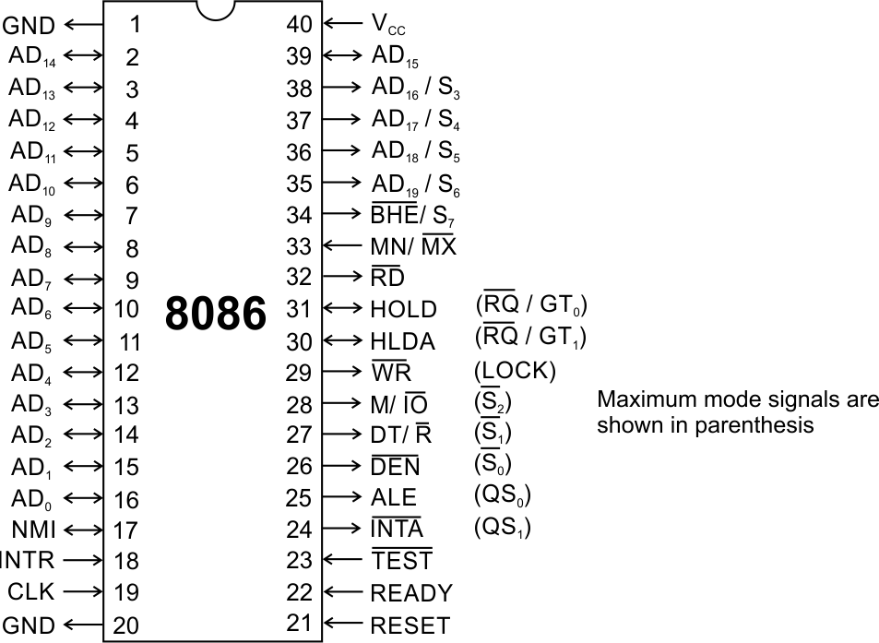

Slide 6
Pins and Signals
Common signals
AD₀-AD₁₅ (Bidirectional)
Address/Data bus
Low order address bus; these are multiplexed with data.
When AD lines are used to transmit memory address the symbol A is used instead of AD, for example A₀-A₁₅.
When data are transmitted over AD lines the symbol D is used in place of AD, for example D₀-D₇, D₈-D₁₅ or D₀-D₁₅.
A₁₆/S₃, A₁₇/S₄, A₁₈/S₅, A₁₉/S₆
High order address bus. These are multiplexed with status signals

Slide 7
Pins and Signals
8086 Microprocessor
Common signals
BHE (Active Low)/S₇ (Output)
Bus High Enable/Status
It is used to enable data onto the most significant half of data bus, D₈-D₁₅. 8-bit device connected to upper half of the data bus use BHE (Active Low) signal. It is multiplexed with status signal S₇.
MN/ MX
MINIMUM / MAXIMUM
This pin signal indicates what mode the processor is to operate in.
RD (Read) (Active Low)
The signal is used for read operation.
It is an output signal.
It is active when low.

Slide 8
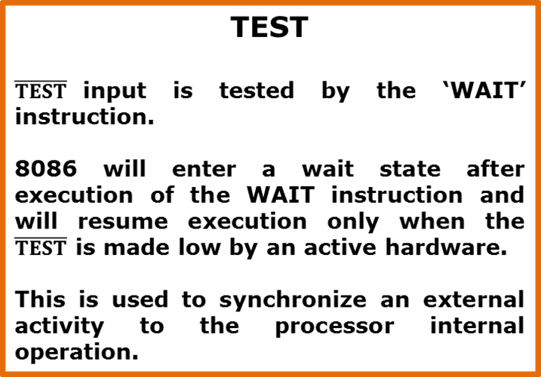
Pins and Signals
8086 Microprocessor
Common signals
READY
This is the acknowledgement from the slow device or memory that they have completed the data transfer.
The signal made available by the devices is synchronized by the 8284A clock generator to provide ready input to the 8086.
The signal is active high.

Slide 9
Pins and Signals
8086 Microprocessor
Common signals
RESET (Input)
Causes the processor to immediately terminate its present activity.
The signal must be active HIGH for at least four clock cycles.
CLK
The clock input provides the basic timing for processor operation and bus control activity. Its an asymmetric square wave with 33% duty cycle.
INTR Interrupt Request
This is a triggered input. This is sampled during the last clock cycles of each instruction to determine the availability of the request. If any interrupt request is pending, the processor enters the interrupt acknowledge cycle.
This signal is active high and internally synchronized.
Notes:
Triggered…বন্দুক ছুড়িবার জন্য কল, Interrupt …বাধা

Slide 10
Pins and Signals
8086 Microprocessor
Min/ Max Pins
The 8086 microprocessor can work in two modes of operations : Minimum mode and Maximum mode.
In the minimum mode of operation the microprocessor do not associate with any co-processors and can not be used for multiprocessor systems.
In the maximum mode the 8086 can work in multi-processor or co-processor configuration.
Minimum or maximum mode operations are decided by the pin MN/ MX(Active low).
When this pin is high 8086 operates in minimum mode otherwise it operates in Maximum mode.

Slide 11
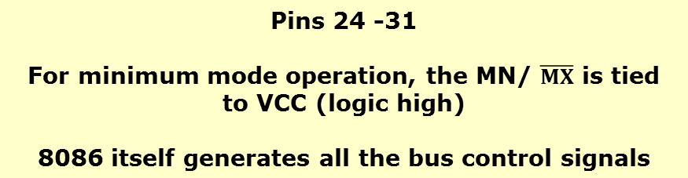



Pins and Signals
8086 Microprocessor
Minimum mode signals
ALE | (Address Latch Enable) Used to demultiplex the address and data lines using external latches

Slide 12
Pins and Signals
8086 Microprocessor
Minimum mode signals
HOLD | Input signal to the processor form the bus masters as a request to grant the control of the bus. Usually used by the DMA (DIRECT MEMORY ACCES) controller to get the control of the bus.
HLDA | (Hold Acknowledge) Acknowledge signal by the processor to the bus master requesting the control of the bus through HOLD. The acknowledge is asserted high, when the processor accepts HOLD.

Slide 13
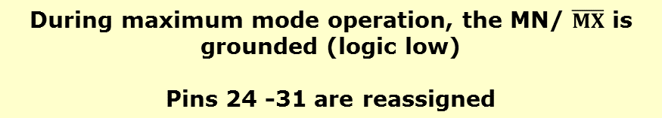
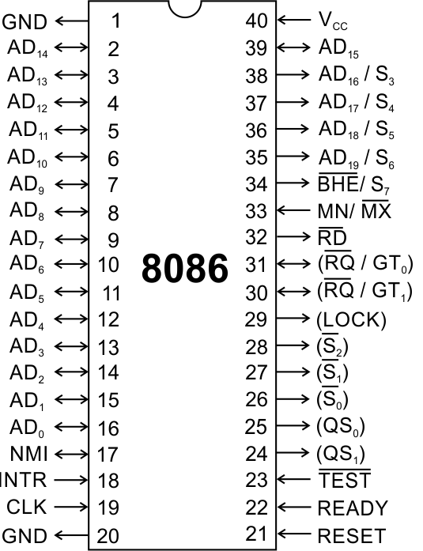
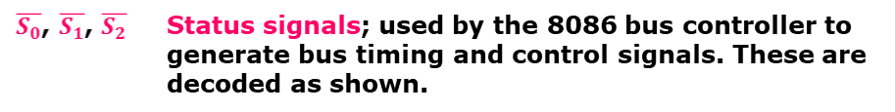
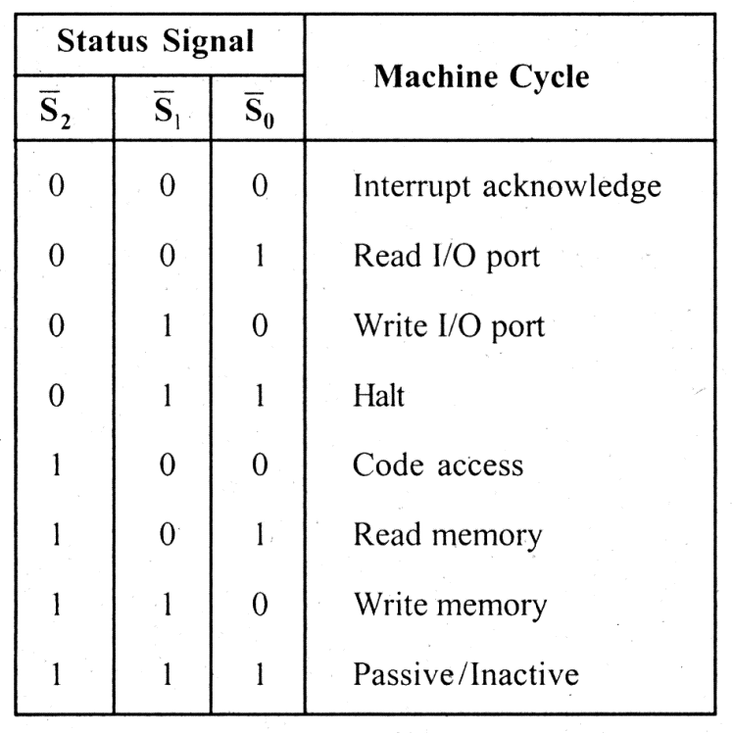
Pins and Signals
8086 Microprocessor
Maximum mode signals
Notes:
Halt..থামা

Slide 14
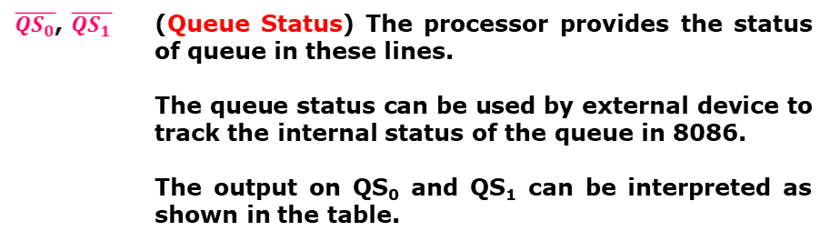
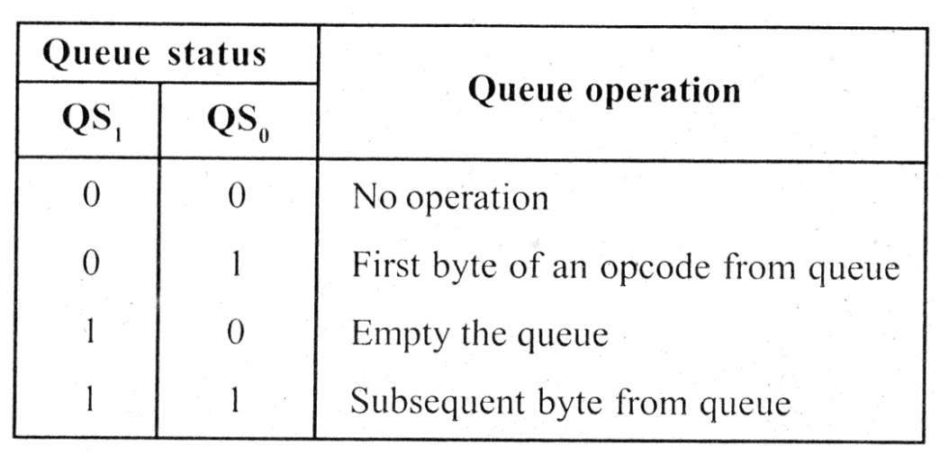
Pins and Signals
8086 Microprocessor
Maximum mode signals
Notes:
opcode- এর সংজ্ঞা একটি কম্পিউটার কোড যা অপারেটিং নির্দেশাবলী অন্তর্ভুক্ত। subsequent…পরবর্তী

Slide 15
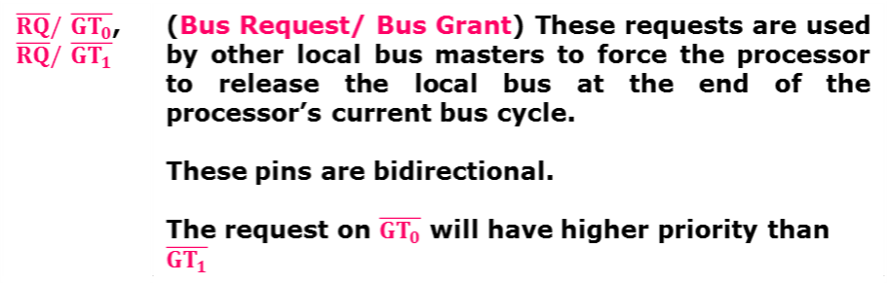
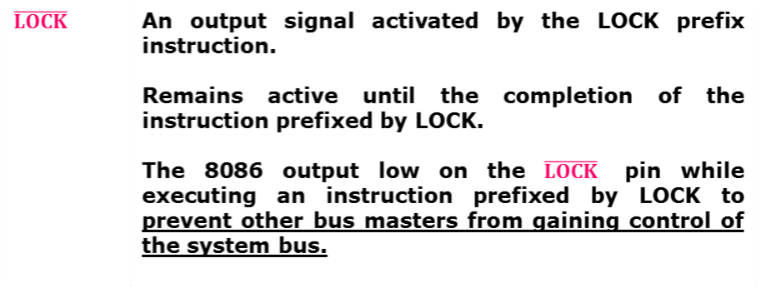
Pins and Signals
8086 Microprocessor
Maximum mode signals

Slide 16
8086 Architecture

Slide 17
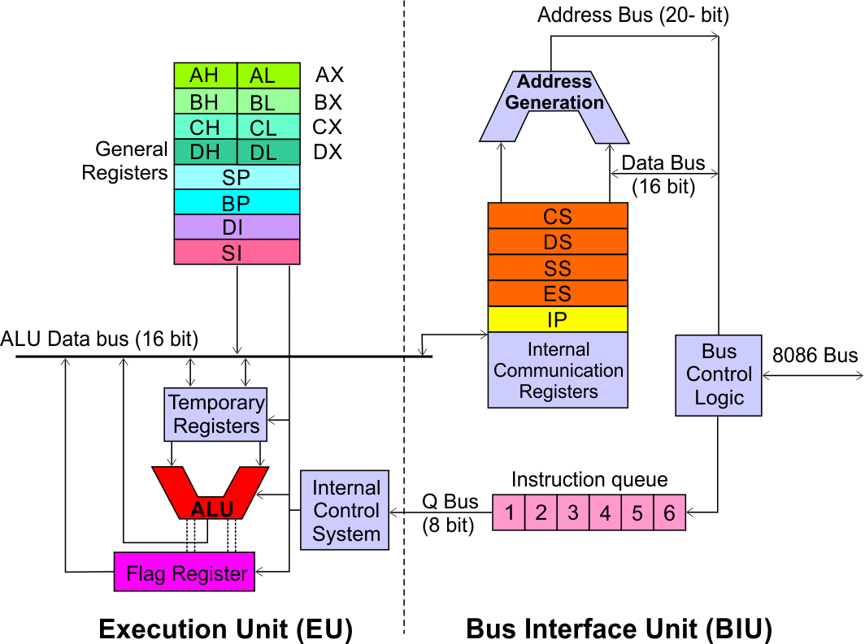
Architecture
8086 Microprocessor
Execution Unit (EU)
EU executes instructions that have already been fetched by the BIU.
BIU and EU functions separately.
Bus Interface Unit (BIU)
BIU fetches instructions, reads data from memory and I/O ports, writes data to memory and I/ O ports.
Notes:
Fetched---আনা

Slide 18
8086 Microprocessor
Bus Interface Unit (BIU)
Dedicated Adder to generate 20 bit address
Four 16-bit segment registers
Code Segment (CS)
Data Segment (DS)
Stack Segment (SS)
Extra Segment (ES)
Segment Registers >>

Slide 19
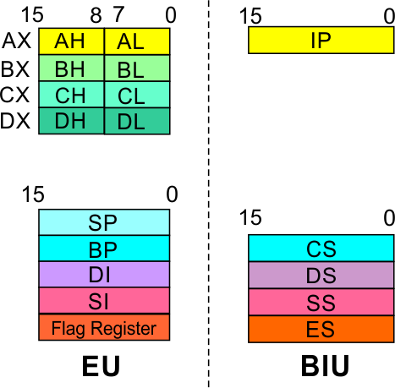
Architecture
8086 Microprocessor
Bus Interface Unit (BIU)
Segment
Registers
Code Segment Register
16-bit
CS contains the base or start of the current code segment; IP contains the distance or offset from this address to the next instruction byte to be fetched.
BIU computes the 20-bit physical address by logically shifting the contents of CS 4-bits to the left and then adding the 16-bit contents of IP.
That is, all instructions of a program are relative to the contents of the CS register multiplied by 16 and then offset is added provided by the IP.
Notes:
Offset…প্রশাখা

Slide 20
Architecture
8086 Microprocessor
Bus Interface Unit (BIU)
Segment
Registers
Data Segment Register
16-bit
Points to the current data segment; operands for most instructions are fetched from this segment.
The 16-bit contents of the Source Index (SI) or Destination Index (DI) or a 16-bit displacement are used as offset for computing the 20-bit physical address.

Slide 21
Architecture
8086 Microprocessor
Bus Interface Unit (BIU)
Segment
Registers
Stack Segment Register
16-bit
Points to the current stack.
The 20-bit physical stack address is calculated from the Stack Segment (SS) and the Stack Pointer (SP) for stack instructions such as PUSH and POP.
In based addressing mode, the 20-bit physical stack address is calculated from the Stack segment (SS) and the Base Pointer (BP).

Slide 22
Architecture
8086 Microprocessor
Bus Interface Unit (BIU)
Segment
Registers
Extra Segment Register
16-bit
Points to the extra segment in which data (in excess of 64K pointed to by the DS) is stored.
String instructions use the ES and DI to determine the 20-bit physical address for the destination.

Slide 23
Architecture
8086 Microprocessor
Bus Interface Unit (BIU)
Segment
Registers
Instruction Pointer
16-bit
Always points to the next instruction to be executed within the currently executing code segment.
So, this register contains the 16-bit offset address pointing to the next instruction code within the 64Kb of the code segment area.
Its content is automatically incremented as the execution of the next instruction takes place.

Slide 24
8086 Microprocessor
Bus Interface Unit (BIU)
Instruction queue
A group of First-In-First-Out (FIFO) in which up to 6 bytes of instruction code are pre fetched from the memory ahead of time.
This is done in order to speed up the execution by overlapping instruction fetch with execution.
This mechanism is known as pipelining.

Slide 25
Architecture
8086 Microprocessor
Execution Unit (EU)
EU decodes and executes instructions.
A decoder in the EU control system translates instructions.
16-bit ALU for performing arithmetic and logic operation
Four general purpose registers(AX, BX, CX, DX);
Pointer registers (Stack Pointer, Base Pointer);
and
Index registers (Source Index, Destination Index) each of 16-bits
Some of the 16 bit registers can be used as two 8 bit registers as :
AX can be used as AH and AL
BX can be used as BH and BL
CX can be used as CH and CL
DX can be used as DH and DL

Slide 26
Architecture
8086 Microprocessor
Execution Unit (EU)
EU
Registers
Accumulator Register (AX)
Consists of two 8-bit registers AL and AH, which can be combined together and used as a 16-bit register AX.
AL in this case contains the low order byte of the word, and AH contains the high-order byte.
The I/O instructions use the AX or AL for inputting / outputting 16 or 8 bit data to or from an I/O port.
Multiplication and Division instructions also use the AX or AL.

Slide 27
Architecture
8086 Microprocessor
Execution Unit (EU)
EU
Registers
Base Register (BX)
Consists of two 8-bit registers BL and BH, which can be combined together and used as a 16-bit register BX.
BL in this case contains the low-order byte of the word, and BH contains the high-order byte.
This is the only general purpose register whose contents can be used for addressing the 8086 memory.
All memory references utilizing this register content for addressing use DS as the default segment register.

Slide 28
Architecture
8086 Microprocessor
Execution Unit (EU)
EU
Registers
Counter Register (CX)
Consists of two 8-bit registers CL and CH, which can be combined together and used as a 16-bit register CX.
When combined, CL register contains the low order byte of the word, and CH contains the high-order byte.
Instructions such as SHIFT, ROTATE and LOOP use the contents of CX as a counter.
Example:
The instruction LOOP START automatically decrements CX by 1 without affecting flags and will check if [CX] = 0.
If it is zero, 8086 executes the next instruction; otherwise the 8086 branches to the label START.

Slide 29
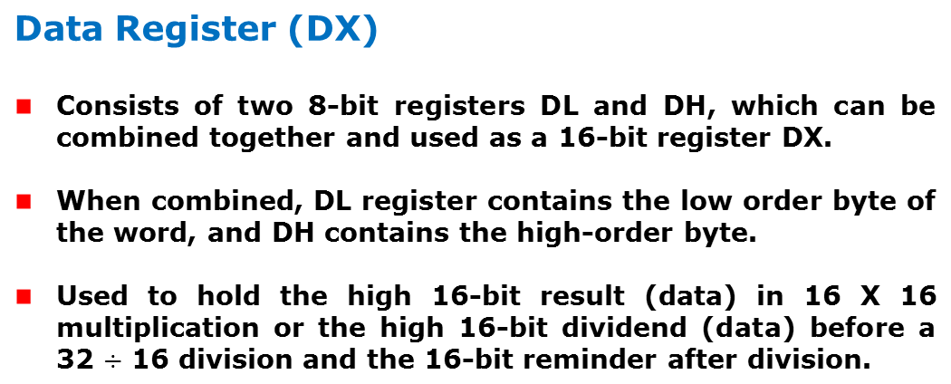
Architecture
8086 Microprocessor
Execution Unit (EU)
EU
Registers

Slide 30
Architecture
8086 Microprocessor
Execution Unit (EU)
EU
Registers
Stack Pointer (SP) and Base Pointer (BP)
SP and BP are used to access data in the stack segment.
SP is used as an offset from the current SS during execution of instructions that involve the stack segment in the external memory.
SP contents are automatically updated (incremented/ decremented) due to execution of a POP or PUSH instruction.
BP contains an offset address in the current SS, which is used by instructions utilizing the based addressing mode.

Slide 31
Architecture
8086 Microprocessor
Execution Unit (EU)
EU
Registers
Source Index (SI) and Destination Index (DI)
Used in indexed addressing.
Instructions that process data strings use the SI and DI registers together with DS and ES respectively in order to distinguish between the source and destination addresses.
Notes:
Indexed,…. সূচিত
Strings are used for storing text/characters. For example, "Hello World" is a string of characters.

Slide 32
Architecture
8086 Microprocessor
Execution Unit (EU)
EU
Registers
Source Index (SI) and Destination Index (DI)
Used in indexed addressing.
Instructions that process data strings use the SI and DI registers together with DS and ES respectively in order to distinguish between the source and destination addresses.

Slide 33
Architecture
8086 Microprocessor
Execution Unit (EU)
Auxiliary Carry Flag
This is set, if there is a carry from the lowest nibble, i.e, bit three during addition, or borrow for the lowest nibble, i.e, bit three, during subtraction.
Carry Flag
This flag is set, when there is a carry out of MSB in case of addition or a borrow in case of subtraction.
Flag Register
Sign Flag
This flag is set, when the result of any computation is negative
Zero Flag
This flag is set, if the result of the computation or comparison performed by an instruction is zero
Parity Flag
This flag is set to 1, if the lower byte of the result contains even number of 1’s ; for odd number of 1’s set to zero.
15 | 14 | 13 | 12 | 11 | 10 | 9 | 8 | 7 | 6 | 5 | 4 | 3 | 2 | 1 | 0
 |  |  |  | OF | DF | IF | TF | SF | ZF |  | AF |  | PF |  | CF
Over flow Flag
This flag is set, if an overflow occurs, i.e, if the result of a signed operation is large enough to accommodate in a destination register. The result is of more than 7-bits in size in case of 8-bit signed operation and more than 15-bits in size in case of 16-bit sign operations, then the overflow will be set.
Tarp Flag
If this flag is set, the processor enters the single step execution mode by generating internal interrupts after the execution of each instruction
Direction Flag
This is used by string manipulation instructions. If this flag bit is ‘0’, the string is processed beginning from the lowest address to the highest address, i.e., auto incrementing mode. Otherwise, the string is processed from the highest address towards the lowest address, i.e., auto incrementing mode.
Interrupt Flag
Causes the 8086 to recognize external mask interrupts; clearing IF disables these interrupts.

Slide 34
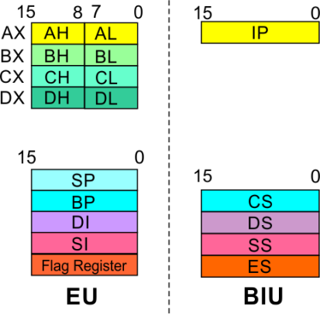
8086 Microprocessor
Architecture
8086 registers categorized into 4 groups
15 | 14 | 13 | 12 | 11 | 10 | 9 | 8 | 7 | 6 | 5 | 4 | 3 | 2 | 1 | 0
 |  |  |  | OF | DF | IF | TF | SF | ZF |  | AF |  | PF |  | CF
Sl.No. | Type | Register width | Name of register
1 | General purpose register | 16 bit | AX, BX, CX, DX
 |  | 8 bit | AL, AH, BL, BH, CL, CH, DL, DH
2 | Pointer register | 16 bit | SP, BP
3 | Index register | 16 bit | SI, DI
4 | Instruction Pointer | 16 bit | IP
5 | Segment register | 16 bit | CS, DS, SS, ES
6 | Flag | 16 bit | Flag register

Slide 35
8086 Microprocessor
Architecture
Registers and Special Functions
Register | Name of the Register | Special Function
AX | 16-bit Accumulator | Stores the 16-bit results of arithmetic and logic operations
AL | 8-bit Accumulator | Stores the 8-bit results of arithmetic and logic operations
BX | Base register | Used to hold base value in base addressing mode to access memory data
CX | Count Register | Used to hold the count value in SHIFT, ROTATE and LOOP instructions
DX | Data Register | Used to hold data for multiplication and division operations
SP | Stack Pointer | Used to hold the offset address of top stack memory
BP | Base Pointer | Used to hold the base value in base addressing using SS register to access data from stack memory
SI | Source Index | Used to hold index value of source operand (data) for string instructions
DI | Data Index | Used to hold the index value of destination operand (data) for string operations

Slide 36
Minimum and Maximum Modes
The minimum mode is selected by applying logic 1 to the MN / MX input pin. This is a single microprocessor configuration.
The maximum mode is selected by applying logic 0 to the MN / MX input pin. This is a multi micro processors configuration.
Microprocessors & Assembly Language - Chapter 2

Slide 37
Minimum Mode 8086 System
In a minimum mode 8086 system, the microprocessor 8086 is operated in minimum mode by strapping its MN/MX pin to logic 1.
In this mode, all the control signals are given out by the microprocessor chip itself.
There is a single microprocessor in the minimum mode system.
The remaining components in the system are latches, transceivers, clock generator, memory and I/O devices.
Some type of chip selection logic may be required for selecting memory or I/O devices, depending upon the address map of the system.
Microprocessors & Assembly Language - Chapter 2
Notes:
Strapping…. চামড়ার ফিতা দিয়া বন্ধন; discuss…. Latch…..দরজার ছিটকিনি transceiver [ট্রেনসীভার] /noun/ রেডিও

Slide 38
Maximum Mode 8086 System
In the maximum mode, the 8086 is operated by strapping the MN/MX pin to 0
In this mode, the processor derives the status signal S2, S1, S0. Another chip called bus controller derives the control signal using this status information .
In the maximum mode, there may be more than one microprocessor in the system configuration.
The components in the system are same as in the minimum mode system
Microprocessors & Assembly Language - Chapter 2

Slide 39
Reference Books:
1. Douglas V. Hall, “Microprocessors and Interfacing ”
2. Barry B. Brey, “The Intel Microprocessors”
Microprocessors & Assembly Language - Chapter 2

Slide 40
Thanks…
Microprocessors & Assembly Language - Chapter 2

